Slide 1
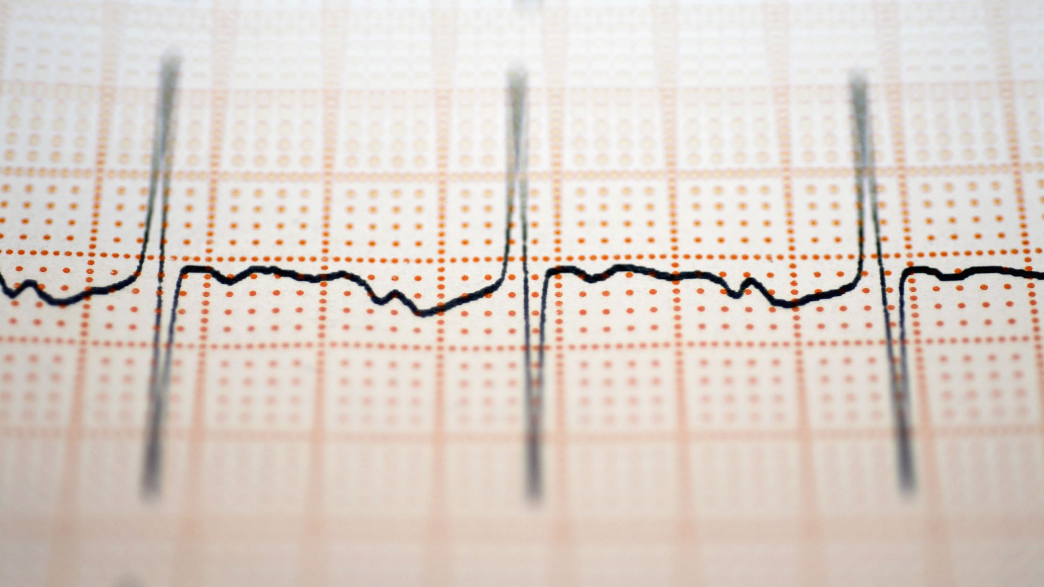
Heart Failure Prediction
Saving Lives with ML Models

Slide 2
Dataset background
Leading Cause of Death:
Cardiovascular diseases (CVDs) are the leading cause of death worldwide.
An estimated 17.9 million people die from CVDs each year.
CVDs account for 31% of all global deaths.
Deadly Outcomes:
Heart attacks and strokes cause four out of five CVD-related deaths.
A significant number of deaths occur prematurely in people under 70.
Importance of Early Detection:
Underscores the critical need for early detection and effective management of heart failure, a common outcome of CVDs.

Slide 3
Dataset background cont.
Game-Changing Dataset:
Merges information from five separate heart disease datasets:
Cleveland, Hungarian, Switzerland, Long Beach VA, and Stalog.
Contains 918 observations.
Largest heart disease dataset available for research to date.
Benefits for Researchers:
Goldmine of information for analyzing cardiovascular risk factors.
Enables the development of disease prediction models.
Strength in Diversity:
Provides a robust foundation for exploring correlations.
Identifying potential predictors and building robust models for early CVD detection and management on a global scale.

Slide 4
Dataset attributes
Age: age of the patient [years]
Sex: sex of the patient [M: Male, F: Female]
ChestPainType: chest pain type [TA: Typical Angina, ATA: Atypical Angina, NAP: Non-Anginal Pain, ASY: Asymptomatic]
RestingBP: resting blood pressure [mm Hg]
Cholesterol: serum cholesterol [mm/dl]
FastingBS: fasting blood sugar [1: if FastingBS > 120 mg/dl, 0: otherwise]
RestingECG: resting electrocardiogram results [Normal: Normal, ST: having ST-T wave abnormality (T wave inversions and/or ST elevation or depression of > 0.05 mV), LVH: showing probable or definite left ventricular hypertrophy by Estes' criteria]
MaxHR: maximum heart rate achieved [Numeric value between 60 and 202]
ExerciseAngina: exercise-induced angina [Y: Yes, N: No]
Oldpeak: oldpeak = ST [Numeric value measured in depression]
ST_Slope: the slope of the peak exercise ST segment [Up: upsloping, Flat: flat, Down: downsloping]
HeartDisease: output class [1: heart disease, 0: Normal]

Slide 5
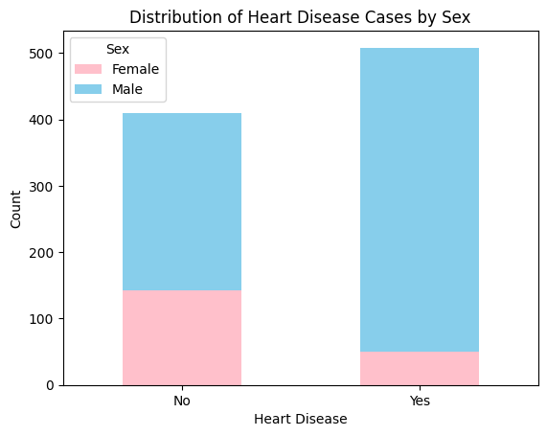
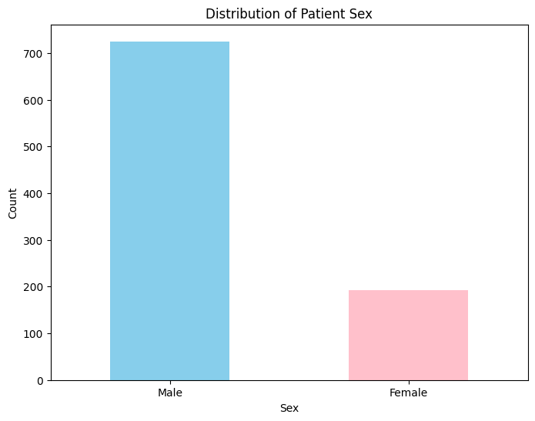
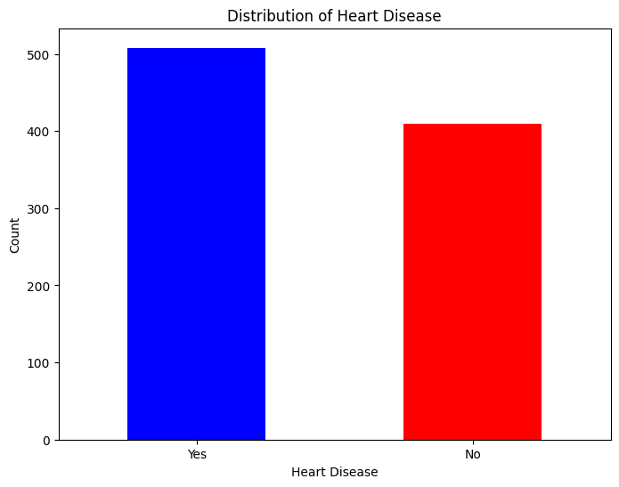
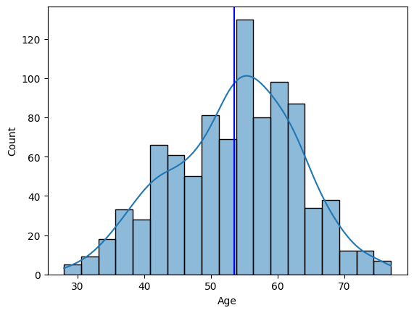
Exploratory data analysis (eda)
Male patients are more represented than female patients in the dataset
Average age is in the mid-50s with most of the data falling between the ages of 40-60
Relatively even split between patients with and without heart disease
Males are far more represented among patients with heart disease

Slide 6
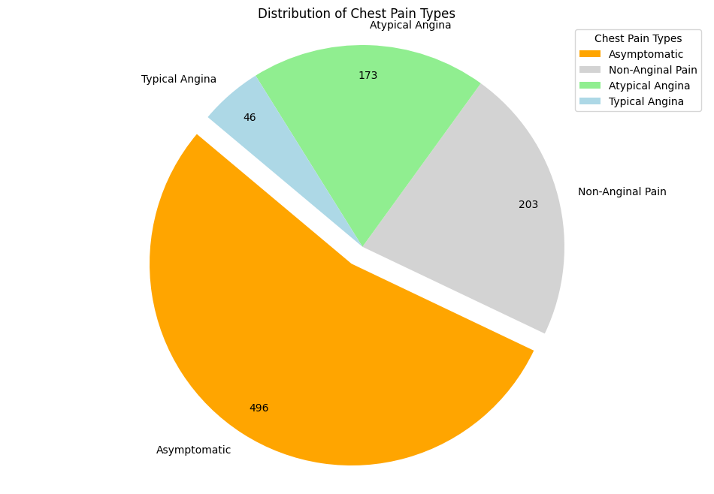
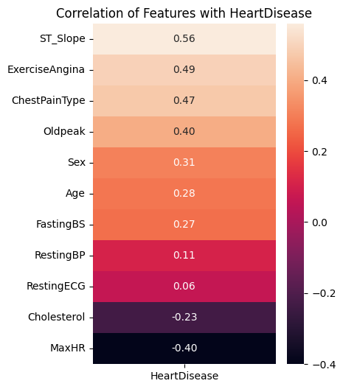
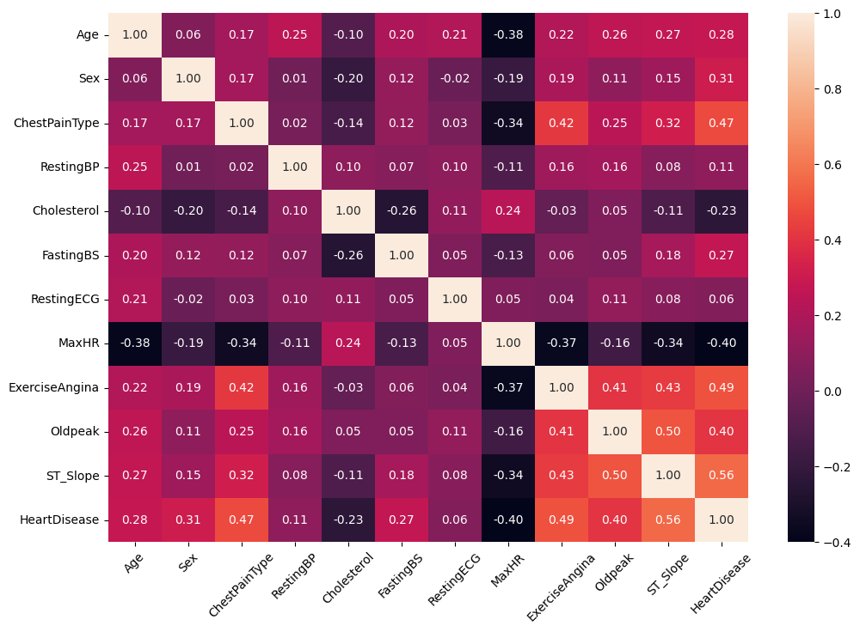
Eda cont.
ASY, or asymptomatic chest pain was by far the highest reported type of chest pain
That means that the patient experienced no prior symptoms before having a heart attack.
Heart Disease was highly correlated with:
ST_Slope
ExerciseAngina
ChestPainType
Oldpeak

Slide 7

ML Models for prediction
We will be using the following machine learning models to predict heart disease:
Logistic Regression
Decision Tree Classifier
Random Forest Classifier
Support Vector Machine (SVM)
Linear Kernel
Gaussian Kernel

Slide 8
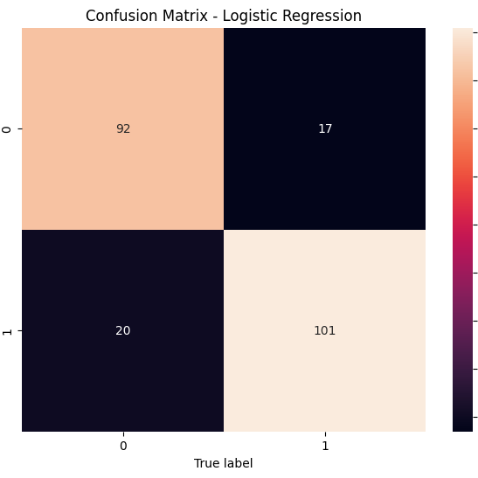
Logistic regression
Model Description
Supervised learning algorithm for binary classification
Used to predict the probability of a binary outcome based on one or more predictor variables
Model Accuracy
0.8391 or 83.91%
Confusion Matrix
True Positives - 101
False Positives - 20
True Negatives - 92
False Negatives - 17
True Positive Rate - 85.59%
True Negative Rate - 82.14%

Slide 9
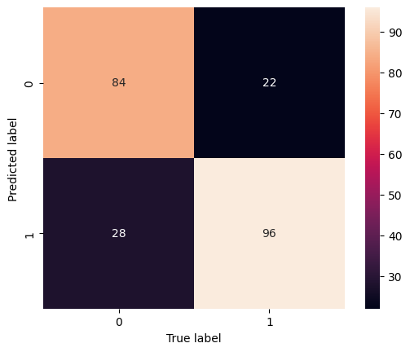
Decision tree classifier
Model Description
Supervised learning algorithm used for both classification and regression
Builds a tree-like model to make decisions
Model Accuracy
0.7826 or 78.26%
Confusion Matrix
True Positives - 96
False Positives - 28
True Negatives - 84
False Negatives - 22
True Positive Rate – 81.36%
True Negative Rate – 75.00%

Slide 10
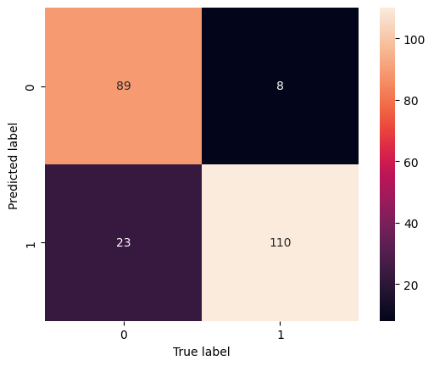
Random forest classifier
Model Description
Ensemble learning method based on decision trees
Builds multiple decision trees and combines their outputs to improve prediction accuracy and control overfitting
Model Accuracy
0.8652 or 86.52%
Confusion Matrix
True Positives - 110
False Positives - 23
True Negatives - 89
False Negatives - 8
True Positive Rate – 93.22%
True Negative Rate – 79.46%

Slide 11
Support vector machine (svm)
Linear
Gaussian
Model Accuracy
0.8435 or 84.35%
Confusion Matrix
True Positives - 103
False Positives - 21
True Negatives - 91
False Negatives - 15
True Positive Rate - 87.29%
True Negative Rate - 81.25%
Model Accuracy
0.8348 or 83.48%
Confusion Matrix
True Positives - 108
False Positives - 28
True Negatives - 84
False Negatives - 10
True Positive Rate - 91.53%
True Negative Rate – 75.00%
Notes:
SVM
Supervised learning algorithm for both classification and regression
Constructs a hyperplane in a high-dimensional space to separate classes

Slide 12
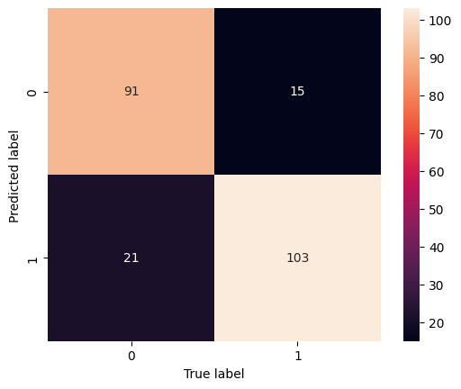
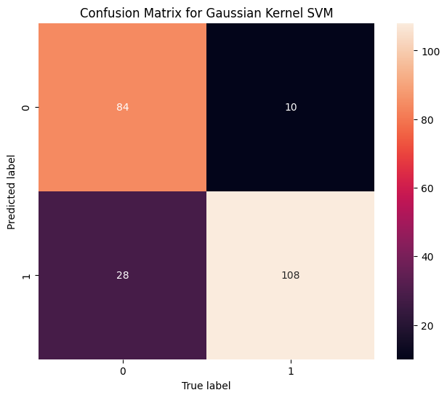
Svm confusion matrices
Linear
gaussian

Slide 13
Final ml model accuracy breakdown
Model | TP | FP | TN | FN | Accuracy | TPR | TNR
Logistic Regression | 101 | 20 | 92 | 17 | 0.8391 | 85.59% | 82.14%
Decision Tree | 96 | 28 | 84 | 22 | 0.7826 | 81.36% | 75.00%
Random Forest | 110 | 23 | 89 | 8 | 0.8652 | 93.22% | 79.46%
Linear Kernel SVM | 103 | 21 | 91 | 15 | 0.8435 | 87.29% | 81.25%
Gaussian Kernel SVM | 108 | 28 | 84 | 10 | 0.8348 | 91.53% | 75.00%

